Slide 1
Recurrent Neural Networks

Slide 2
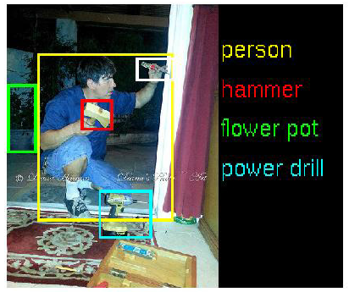
Feed-forward multilayer neural network
So far, we’ve talked about feed-forward network

Slide 3
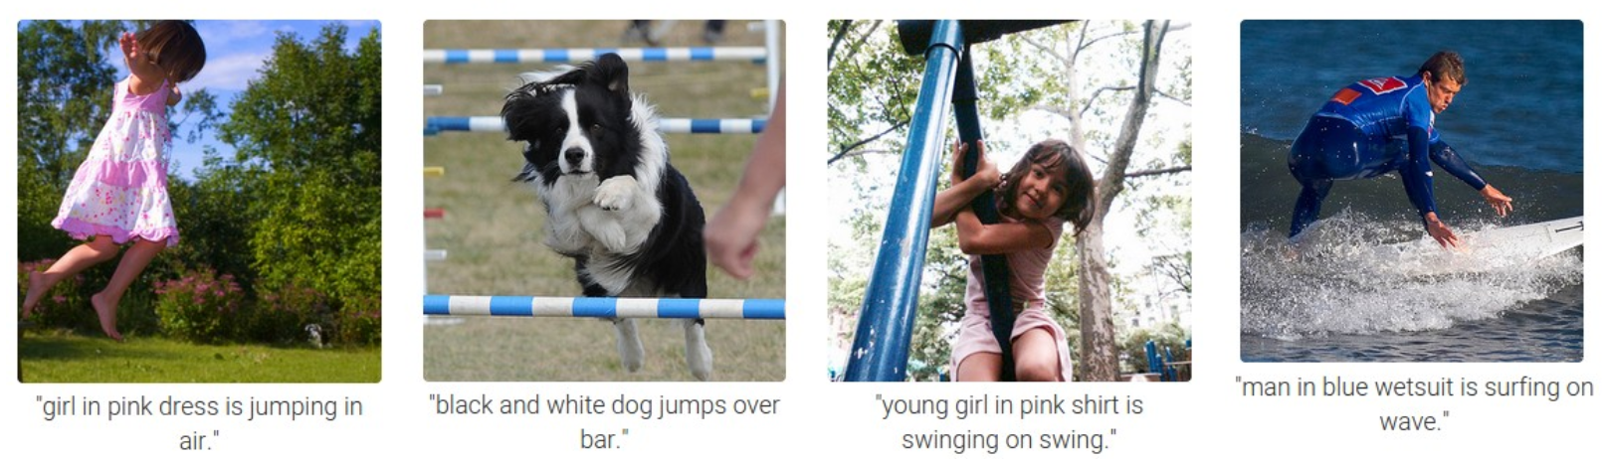
Sequences and time-series data
We find sequential data in many problem domains in industry
for which our model needs to output a sequence of vectors
Automated image captioning
Speech synthesis
Music generation
Playing video games
Language modeling
Notes:
Reference/
<number>

Slide 4
Lost in Time
Limitation of many classification tools (MLP, SVM)
assuming the data is independent
cannot capture long-range time dependencies.
Sliding window techniques:
capture the time dynamic by a sliding window of the input (e.g., the previous, current, and next input together as a single input vector).
limited window width, fail to capture any effects large than the fixed window size.
How can we deal with sequences and time-series data?
Notes:
Reference/
<number>

Slide 5
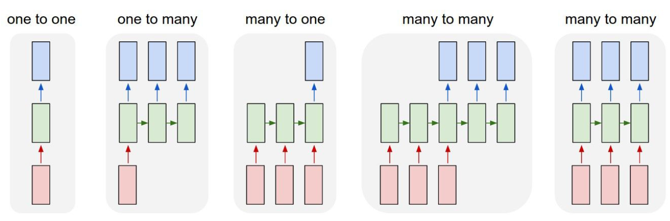
Recurrent Networks offer a lot of flexibility:
Vanilla Neural Networks

Slide 6
Recurrent Networks offer a lot of flexibility:
Image captioning

Slide 7
Recurrent Networks offer a lot of flexibility:
Sentiment Classification:
Words -> sentiment

Slide 8
Recurrent Networks offer a lot of flexibility:
Machine translation:
Sequence of Words -> sequence of words

Slide 9
Recurrent Networks offer a lot of flexibility:
Video classification on frame level

Slide 10
Modeling the Time Dimension
Feed-forward NN
Fixed input size, fixed output size.
RNNs:
One-to-many: sequence output, For example, image captioning takes an image and outputs a sequence of words
Many-to-one: sequence input. For example, sentiment analysis where a given sentence is input
Many-to-many: For example, video classification: label each frame
Notes:
Reference/
<number>

Slide 11
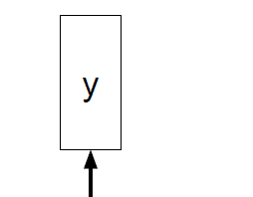
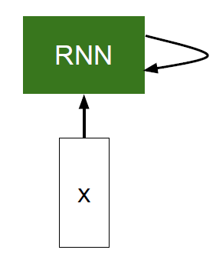
RNN
RNN processes a sequence of inputs by applying a recurrence formula at each time step
usually want to
predict a vector at
some time steps

Slide 12
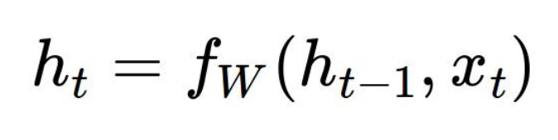
RNN
RNN processes a sequence of inputs by applying a recurrence formula at each time step

Slide 13
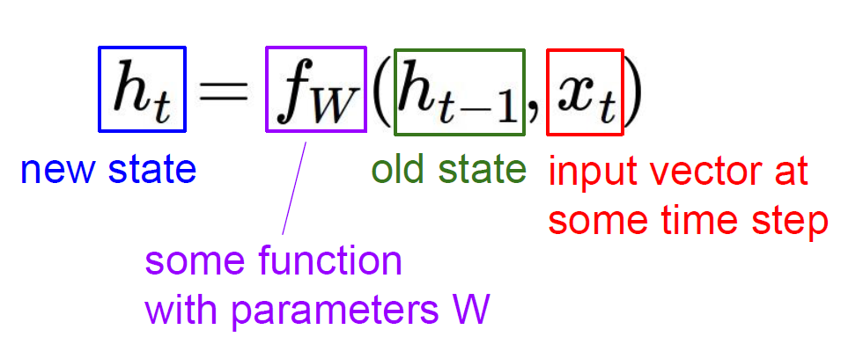
RNN
RNN processes a sequence of inputs by applying a recurrence formula at each time step

Slide 14
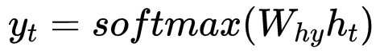
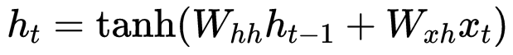
RNN
RNN processes a sequence of inputs by applying a recurrence formula at each time step
Parameter size:

Slide 15
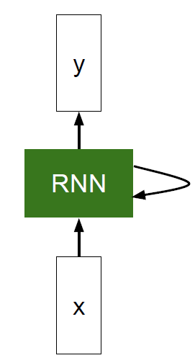
Temporal feedback and loops in connections
RNNs can have loops in the connections.
Model temporal behavior in the data:
Domains: time-series, language, audios, and text.
Data property: inherently ordered and context sensitive where later values depend on previous ones.
Learn from sequence:
Use a feedback loop to learn from sequences, including sequences of varying lengths.
Generate sequences:
The output at each time-step is based on both the current input and the input at all previous time steps.
Notes:
Reference/
<number>

Slide 16
Recurrent Neural Networks (RNNs)
RNNs allow for both parallel and sequential computation, and in principle can compute anything a traditional computer can compute
Unlike traditional computers, however, RNNs are similar to the human brain, which is a large feedback network of connected neurons that somehow can learn to translate a lifelong sensory input stream into a sequence of useful motor outputs
The brain is a remarkable role model as it can solve many problems current machine can not yet solve.
Brain is a super algorithm. Its output is an algorithm.
(Juergen Schmidhuber)
(Gen Matsumoto)
Notes:
Reference/
<number>

Slide 17
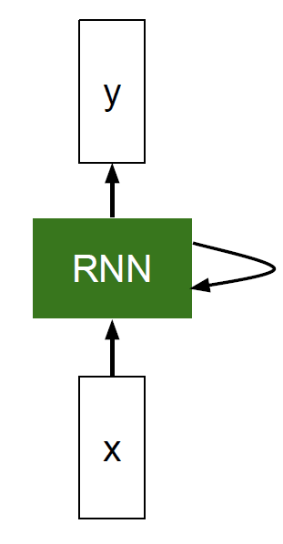
Unfold RNN
RNN processes a sequence of inputs by applying a recurrence formula at each time step
$y_{1}$
$y_{2}$
$y_{3}$
$y_{t}$
…
Unfolding
$h_{1}$
$h_{2}$
$h_{3}$
$h_{t}$
…
$x_{1}$
$x_{2}$
$x_{3}$
$x_{t}$
…

Slide 18
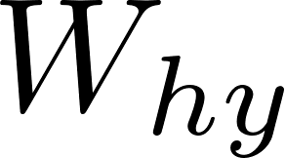
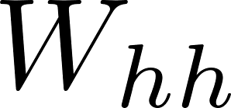
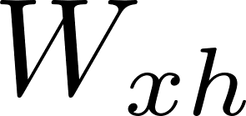
Sharing Parameters
Key idea:
Use the same function and the same set of parameters at every time step
$y_{1}$
$y_{2}$
$y_{3}$
$y_{t}$
…
Unfolding
$h_{1}$
$h_{2}$
$h_{3}$
$h_{t}$
…
$x_{1}$
$x_{2}$
$x_{3}$
$x_{t}$
…

Slide 19
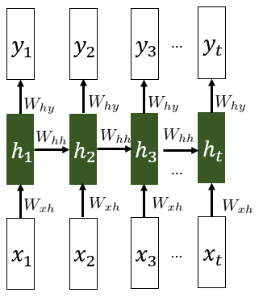
Sharing Parameters
Advantages of parameters sharing
Makes it possible to extend and apply the model to examples of different lengths and generalize across them.
Particularly important when a specific piece of information can occur at multiple positions within the sequence.
share statistical strength across different sequence lengths and across different positions in time
Notes:
for each value of the time index, we could not generalize to sequence lengths not seen during training, and not share statistical strength across different sequence lengths and across different positions in time.
<number>

Slide 20
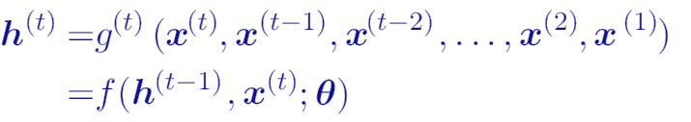
Unfolding RNN
Represent the unfolded recurrence after t steps
Two major advantages:
The learned model always has the same input size regardless of the sequence length
Use the same transition function f with the same parameters at every time step
Notes:
Reference/
<number>

Slide 21
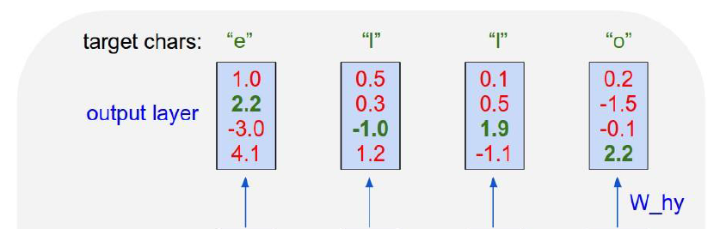
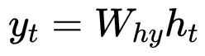
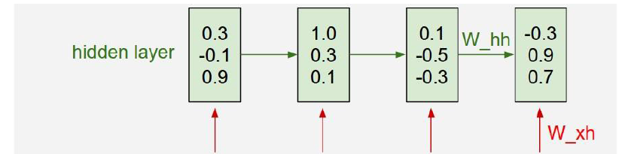
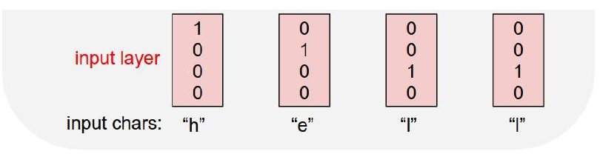
Example: Character-level language model
Vocabulary [H,e,l,o]，
Training sequence: “hello”

Slide 22
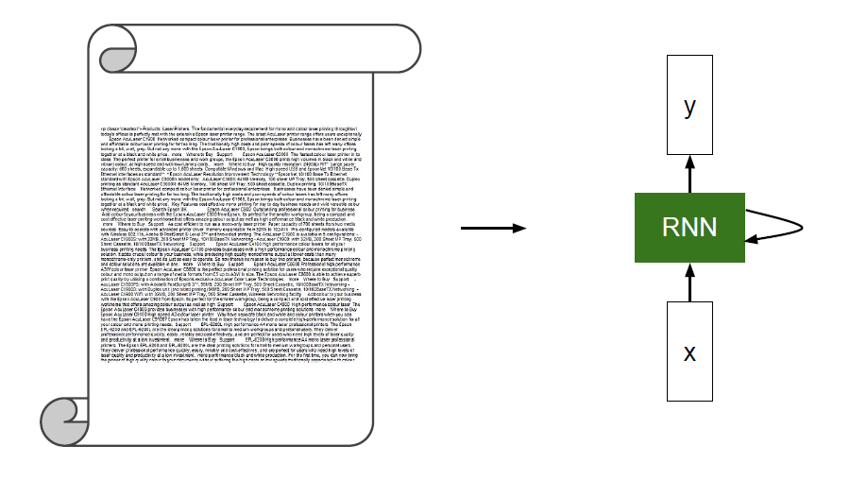
Example: Character-level language model
Training with some articles

Slide 23
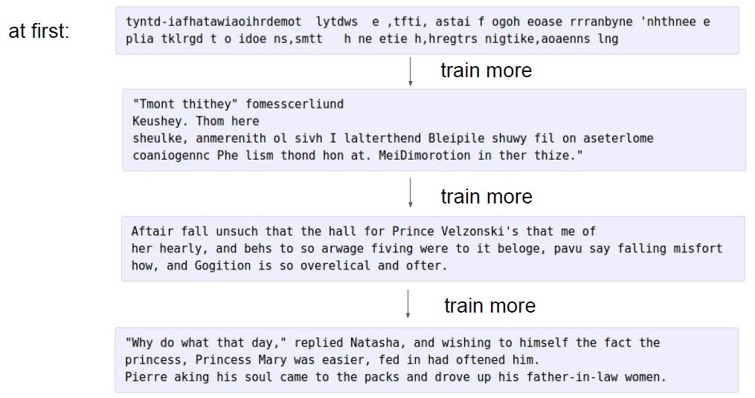
Example: Character-level language model
Results

Slide 24
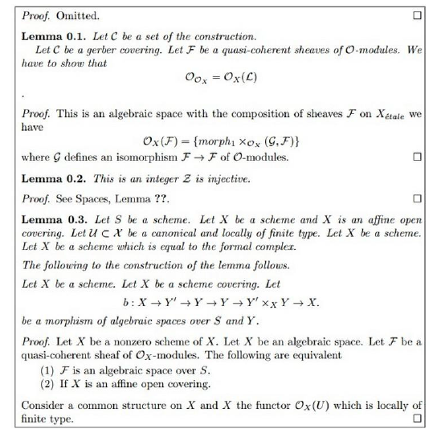
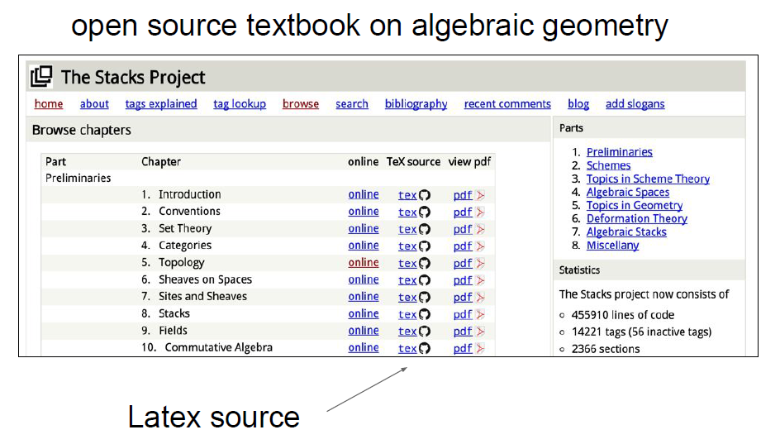
Example: Character-level language model
Training results with latex source
Generated latex text

Slide 25
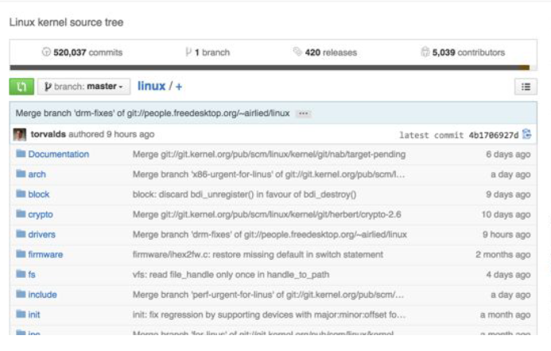
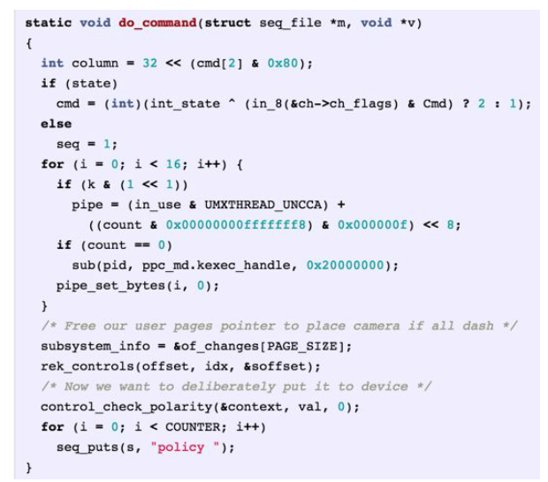
Example: Character-level language model
Training results with code
Training data: linux source code
Generated C code

Slide 26
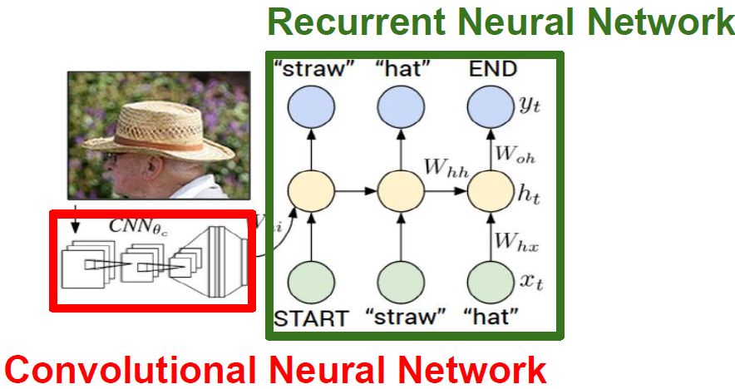
Example: Image captioning
Problem setting

Slide 27
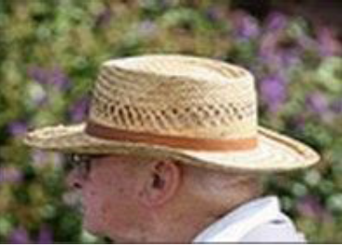
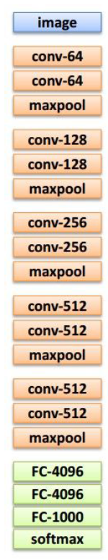
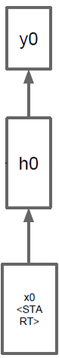
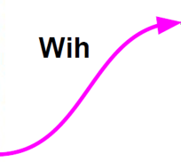
Example: Image captioning
Framework
Test image
Before
Now
Img feature
Start

Slide 28
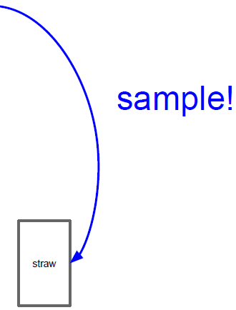
Example: Image captioning
Framework
Test image
Img feature
Start
“Staw”

Slide 29
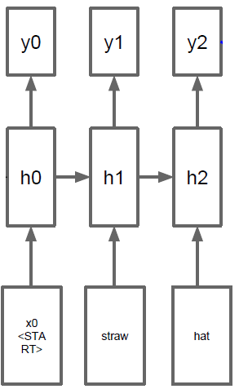
Example: Image captioning
Framework
Test image
Img feature
Start
“Staw”

Slide 30
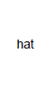
Example: Image captioning
Framework
Test image
Img feature
Start
“Staw”
“Hat”

Slide 31
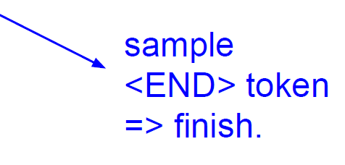
Example: Image captioning
Framework
Test image
Img feature
Start
“Staw”
“Hat”

Slide 32
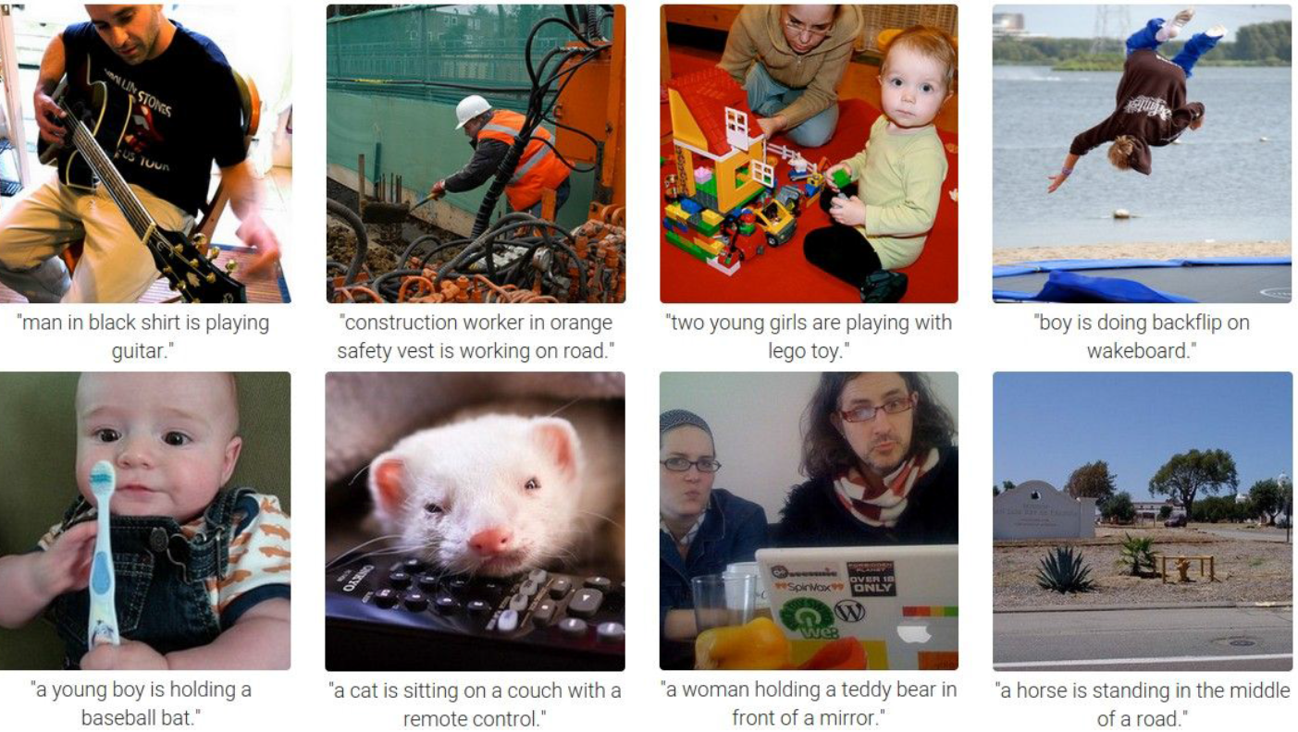
Example: Image captioning
Results

Slide 33
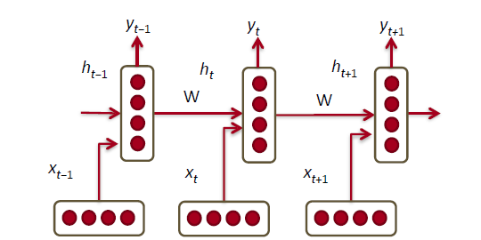
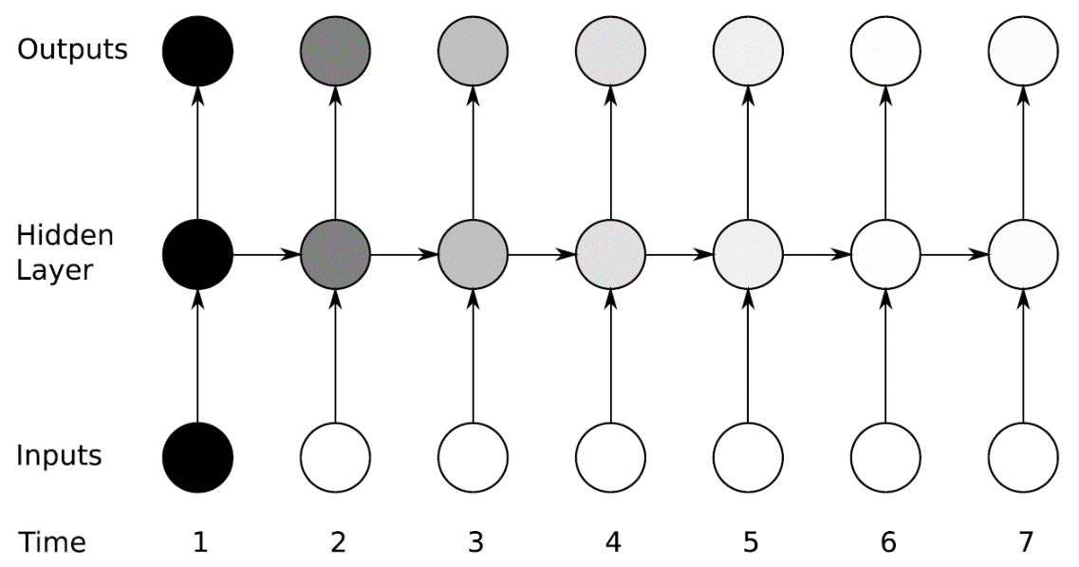
Problem with RNN: training RNN is hard
Multiply the same matrix at each time step during forward propagation
Ideally inputs from many time steps ago can modify output y

Slide 34
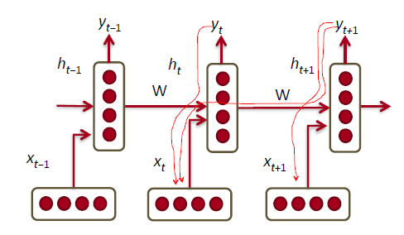
The vanishing/exploding gradient problem
Multiply the same matrix at each time step during backprop
When the gradients become too large or too small and make it difficult to model long-range dependencies (10 time-steps or more) in the structure of the input dataset.

Slide 35
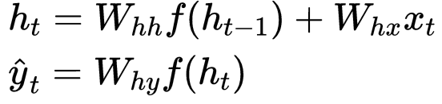
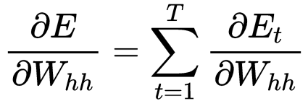
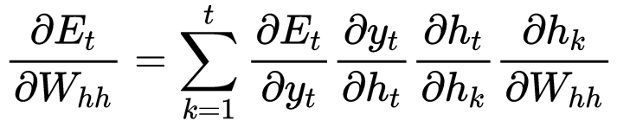
Gradient in RNN
Consider a similar but simpler RNN formulation
Total error is the sum of each error at time steps t
Chain rule

Slide 36
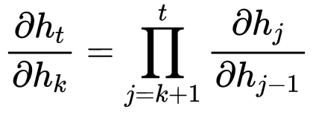
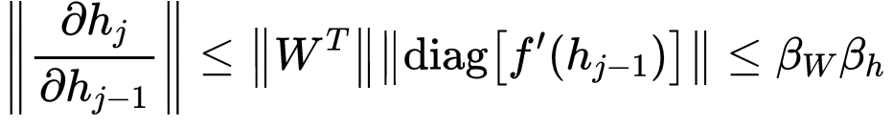
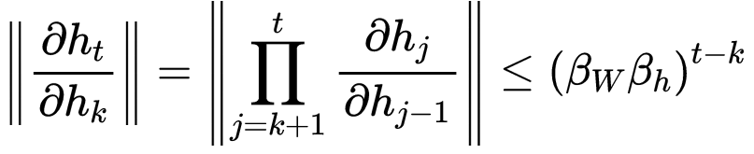
Gradient in RNN
The gradient is a Jacobian matrix
Analyzed the norm of Jacobian
This can become very small or very large quickly [Bengio et al. 1994]
Vanishing/Exploding gradient

Slide 37
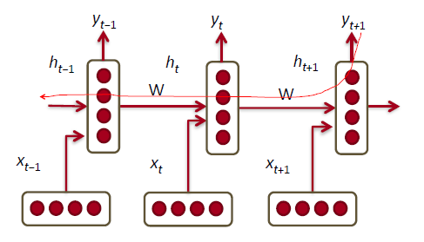
Why is vanishing gradient a problem?
The error at a time step ideally can tell a previous time step from many steps away to change during backprop
Example:
“Jane walked into the room. John walked in too. It was late in the day. Jane said hi to ____”

Slide 38
Solve vanishing/exploding gradient problem
Exploding gradient:
Gradient clipping
Vanishing gradient:
Initialization + Relus
LSTM

Slide 39


From RNN to LSTM
RNN
LSTM

Slide 40
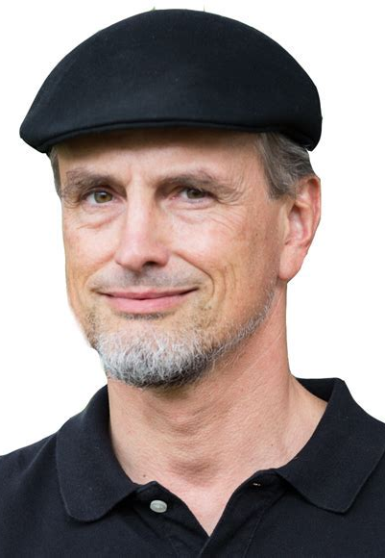
Long-Sort-Term Memory Networks
Introduced in 1997 by Hochreiter and Schmidhuber.
Commonly used variation of RNNs.
Main components of the LSTM:
CELL
GATES
Advantages:
Prevent the vanishing (and exploding) gradient problem
Learn information from long sequences.
Notes:
Reference/
<number>

Slide 41

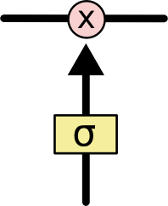

Key idea behind LSTM
Cell state
Very easy for information to just flow along it unchanged.
Gates
Gate function:
remove or add information to the cell state
Gate structure:
a sigmoid neural net layer
a pointwise multiplication operation

Slide 42

Components of LSTM
Forget gate:
what information should be throw away from cell?

Slide 43

Components of LSTM
Input gate:
what information should be store in the cell?
How much we want to update the state value?
New state value

Slide 44

Components of LSTM
Update the old cell
Forget previous information to some extent
Add new information

Slide 45

Components of LSTM
Output gate:
what information should be put in the output?
A filtered version of cell state
Decides what parts of the cell state we’re going to output

Slide 46
Long-Sort-Term Memory Networks
The contents of the memory cell can remain unmodified for a long time (with both of these gates are closed).
Retain information across many steps
Allow gradient flow across many steps
Overcome the vanishing gradient problem
Notes:
Reference/
<number>

Slide 47
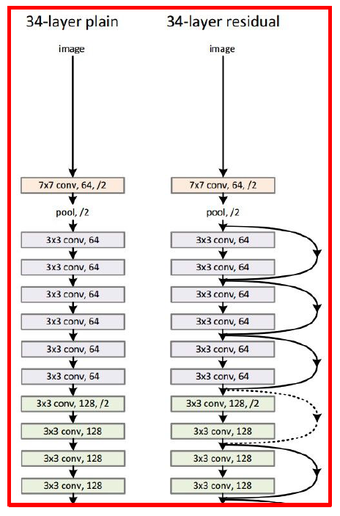
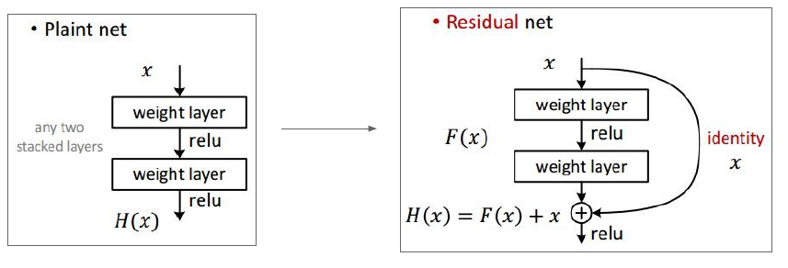
Recall:“PlainNets” vs. ResNets
PlainNet
ResNet
Long-term memory
RNN
LSTM

Slide 48
LSTM Training
LSTM networks use supervised learning to update the weights in the network.
They train on one input vector at a time in a sequence of vectors.
Every noninput unit computes its current activation at any given time-step.
This activation value is computed as the nonlinear function of the weighted sum of the activation of all units from which it receives connections.
For each input vector in the sequence of input, the error is equal to the sum of the deviations of all target signals from corresponding activation computed by the network
Notes:
Reference/
<number>

Slide 49
Multimodal Emotion Recognition Using Deep Neural Networks
Tang, H., Liu, W., Zheng, W.L. and Lu, B.L.Multimodal Emotion Recognition Using Deep Neural Networks. Proc. of International Conference on Neural Information Processing (pp. 811-819)， 2017, November. Springer, Cham.

Slide 50


Multimodal Emotion Recognition using LSTM
Previous work only utilizes current time step’s features.
To incorporate the temporal dependency information of features, we use Long Short Term Memory (LSTM) neural networks as a temporal encoder.
Notes:
Most traditional methods, including the previous Bimodal Deep Denoising AutoEncoder, only used the information of the current time step to predict emotions. The Bimodal-LSTM network, on the other hand, tries to use all information of previous time steps to improve the performance.
<number>

Slide 51

Bimodal-LSTM Network
Two LSTM layers are built for each modality to extract temporal information.
One classification layer with L2-regularized hinge loss.
Dropout is applied for better generalization performance.
Notes:
Reference/
<number>

Slide 52

Experiment details: EEG feature extraction
The feature extraction procedure includes STFT, and power spectral density calculation. (Example on SEED: Window size of STFT is 4-s without overlapping, 5 bands for 62 channels → Totally 900 310-dimension feature vectors; for each movie clip, there are 60 310-dimension feature vectors continuously in temporal domain.)
Notes:
Next, we will extract some useful features from these signals.
First we apply 4-second non-overlapping Hanning windows to EEG signals, and then the windowed signals are transformed into frequency domain with short-time Fourier transform. There are 5 key bands for EEG signals, delta band, theta band, alpha band, beta band and gamma band. So after we transformed the data into frequency domain, we separate these 5 bands and calculate the PSD and DE features. PSD is short for Power spectral and DE is short for differential entropy.
PSD features can be seen as the sum of magnitude of signal in frequency domain, and DE features can be calculated from PSD features.
In our previous results, DE features usually performs better than PSD features.
As for eye movement signals, we extract some statistics features. These statistics includes blink frequency, fixation frequency, saccade frequency and other statistics.
Furthermore, we calculated some features based on these statistics. For example, we calculated the mean value, standard deviation and PSD/DE features for pupil diameter.
<number>

Slide 53







Experiment details: preprocessing
Notes:
Next, we will extract some useful features from these signals.
First we apply 4-second non-overlapping Hanning windows to EEG signals, and then the windowed signals are transformed into frequency domain with short-time Fourier transform. There are 5 key bands for EEG signals, delta band, theta band, alpha band, beta band and gamma band. So after we transformed the data into frequency domain, we separate these 5 bands and calculate the PSD and DE features. PSD is short for Power spectral and DE is short for differential entropy.
PSD features can be seen as the sum of magnitude of signal in frequency domain, and DE features can be calculated from PSD features.
In our previous results, DE features usually performs better than PSD features.
As for eye movement signals, we extract some statistics features. These statistics includes blink frequency, fixation frequency, saccade frequency and other statistics.
Furthermore, we calculated some features based on these statistics. For example, we calculated the mean value, standard deviation and PSD/DE features for pupil diameter.
<number>

Slide 54


Experiment details: off-line implementation
Notes:
<number>

Slide 55

Experiment details: off-line implementation
Notes:
<number>

Slide 56

Experiment details: off-line implementation
Notes:
<number>

Slide 57
Experiment details: LSTM implementation
__call__ function could be implemented in the C++ backend for all RNN cells for more efficiency.
Naïve Pseudocode (Python+Tensorflow Style)
```input_tensor has shape [N’,T,D]
return output_tensor with shape [N’,T,h]```
output_tensor_list = []
hidden_states = tf.zeros([N’,T,h])
cell_states = tf.zeros([N’,T,h])
for i in range(T):
hidden_states,cell_states = one_step(input_tensor[:,i], hidden_states, cell_states)
output_tensor_list.append(hidden_states)
return tf.stack(output_tensor_list,axis=1)
Notes:
<number>

Slide 58

Experiment details: LSTM implementation
Notes:
<number>

Slide 59


Experiment details: LSTM example
Notes:
<number>

Slide 60

Experiment details: Online implementation
Notes:
<number>

Slide 61


LSTM VS Feed-Forward NN
Feed-Forward samples
EEG Features
LSTM samples
Notes:
Next, we will extract some useful features from these signals.
First we apply 4-second non-overlapping Hanning windows to EEG signals, and then the windowed signals are transformed into frequency domain with short-time Fourier transform. There are 5 key bands for EEG signals, delta band, theta band, alpha band, beta band and gamma band. So after we transformed the data into frequency domain, we separate these 5 bands and calculate the PSD and DE features. PSD is short for Power spectral and DE is short for differential entropy.
PSD features can be seen as the sum of magnitude of signal in frequency domain, and DE features can be calculated from PSD features.
In our previous results, DE features usually performs better than PSD features.
As for eye movement signals, we extract some statistics features. These statistics includes blink frequency, fixation frequency, saccade frequency and other statistics.
Furthermore, we calculated some features based on these statistics. For example, we calculated the mean value, standard deviation and PSD/DE features for pupil diameter.
<number>

Slide 62

LSTM VS Feed-Forward NN
Tensor Flow
Feed-Forward: from low layers to higher layers; no connections among different time steps.
LSTM: states propagated through time; the processing order is the same as the chronological order.
Notes:
Next, we will extract some useful features from these signals.
First we apply 4-second non-overlapping Hanning windows to EEG signals, and then the windowed signals are transformed into frequency domain with short-time Fourier transform. There are 5 key bands for EEG signals, delta band, theta band, alpha band, beta band and gamma band. So after we transformed the data into frequency domain, we separate these 5 bands and calculate the PSD and DE features. PSD is short for Power spectral and DE is short for differential entropy.
PSD features can be seen as the sum of magnitude of signal in frequency domain, and DE features can be calculated from PSD features.
In our previous results, DE features usually performs better than PSD features.
As for eye movement signals, we extract some statistics features. These statistics includes blink frequency, fixation frequency, saccade frequency and other statistics.
Furthermore, we calculated some features based on these statistics. For example, we calculated the mean value, standard deviation and PSD/DE features for pupil diameter.
<number>

Slide 63

Experimental Results – SEED dataset
Bimodal-LSTM achieves the best accuracy (93.97%) and the smallest standard deviation (7.03%).
Liu, W., Zheng, W.L., Lu, B.L.: Emotion recognition using multimodal deep learning. In: Hirose, A., Ozawa, S., Doya, K., Ikeda, K., Lee, M., Liu, D. (eds.) ICONIP 2016. LNCS, vol. 9948, pp. 521–529. Springer, Cham (2016).
Yang, Y., Wu, Q.J., Zheng, W.L., Lu, B.L.: EEG-based emotion recognition using hierarchical network with subnetwork nodes. IEEE Transactions on Cognitive and Developmental Systems (2017)

Slide 64
Summary
RNNs allow a lot of flexibility in architecture design
Vanilla RNNs are simple but don’t work very well
Common to use LSTM: improve gradient flow
Backward flow of gradients in RNN can explode or vanish.
Exploding is controlled with gradient clipping.
Vanishing is controlled with additive interactions (LSTM)
Better/simpler architectures are a hot topic of current research
Better understanding (both theoretical and empirical) is needed.

Slide 65
Resources on RNN
Josh Patterson and Adam Gibson, Deep Learning, A Practitioner’s Approach, O’reilly, 2017
2、Ian Goodfellow, Yoshua Bengio, and Aaron Courville, Deep Learning, MIT Press, 2016
3、Alex Graves, Supervised Sequence Labelling with Recurrent Neural Networks, Springer, 2012

